Slide 1
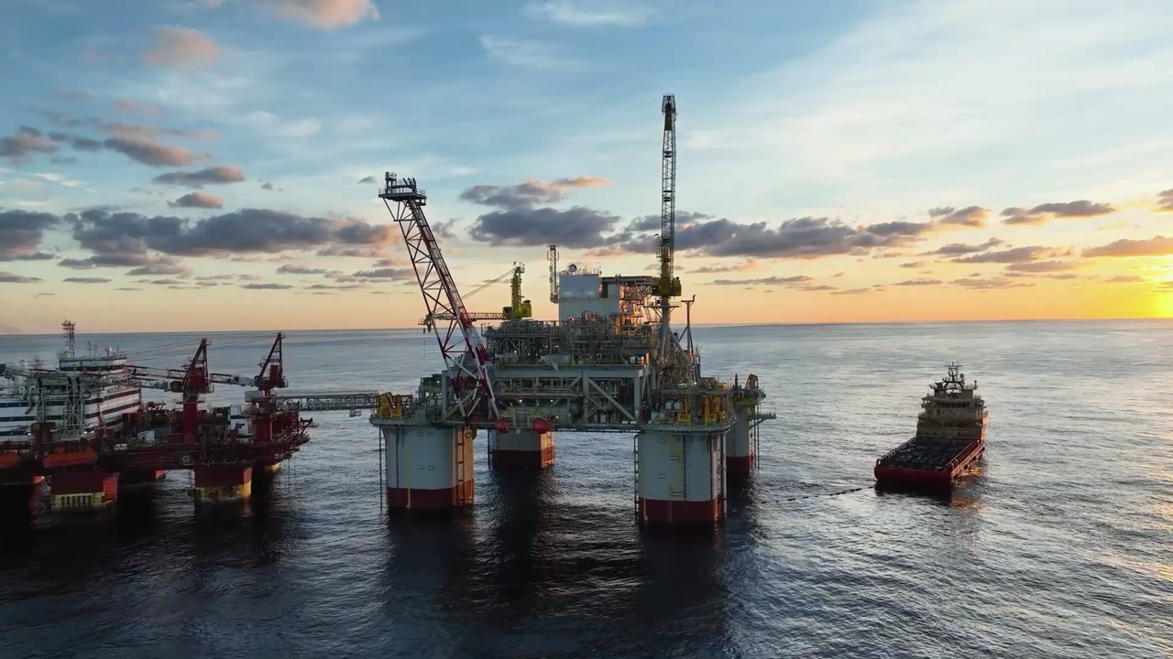


Slide 2
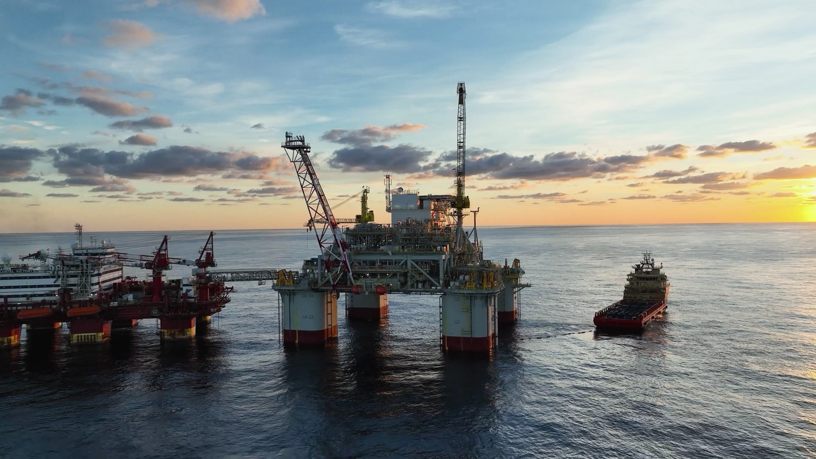
PREDICTION
VEHICLE POPULATION
2025
START

Slide 3
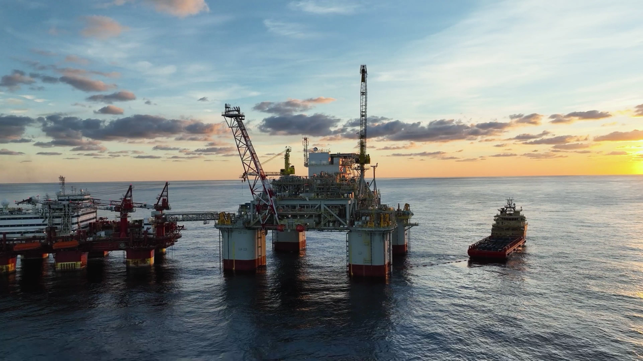
P R O B L E M O V E R V I E W
Predicting future demand
Understanding vehicle population and miles traveled.
Traditional vehicle inventories lack real-time data and future projections.
Data science can uncover insights by analyzing:
Model year
Vehicle type
Fuel type
Using data from 2019 to 2024, we aim to predict vehicle population in 2025.
These insights will help anticipate fuel consumption trends and guide strategic decisions.

Slide 4
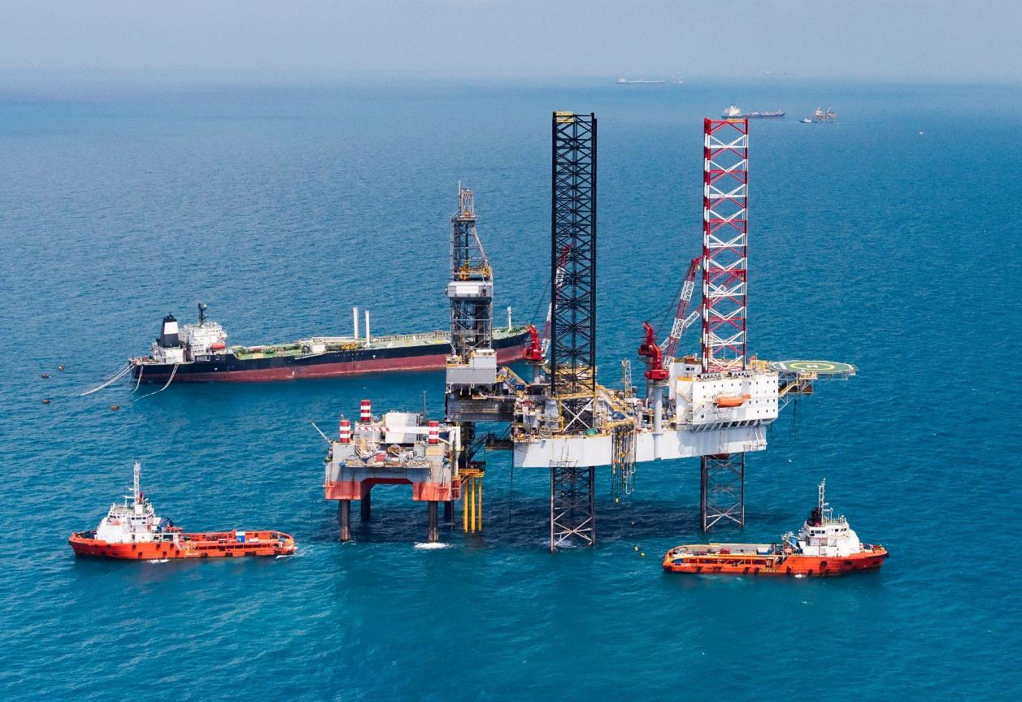




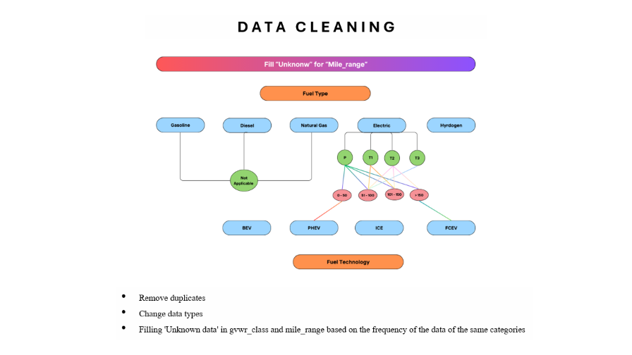
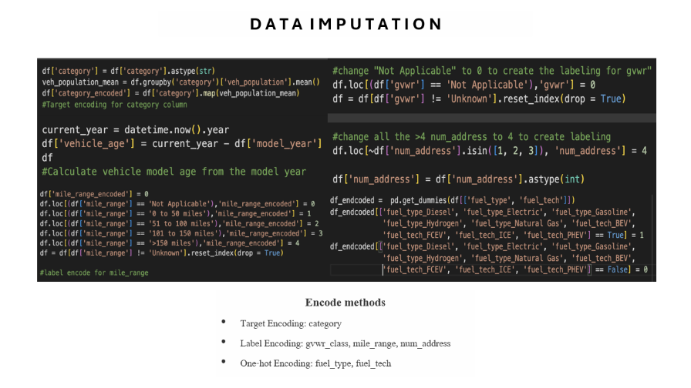
D A T A W R A N G L I N G
01
02
03
04
05

Slide 5
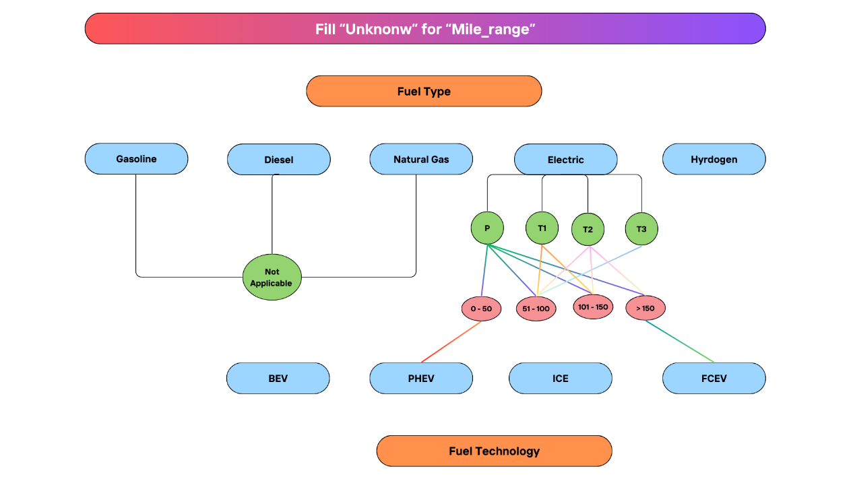
D A T A C L E A N I N G
Remove duplicates
Change data types
Filling 'Unknown data' in gvwr_class and mile_range based on the frequency of the data of the same categories

Slide 6
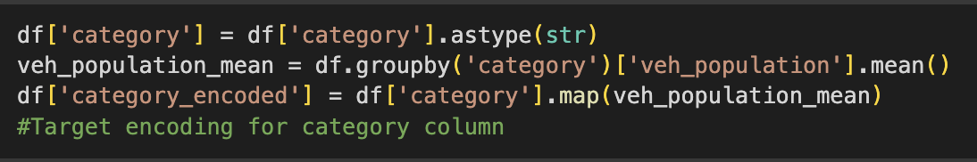
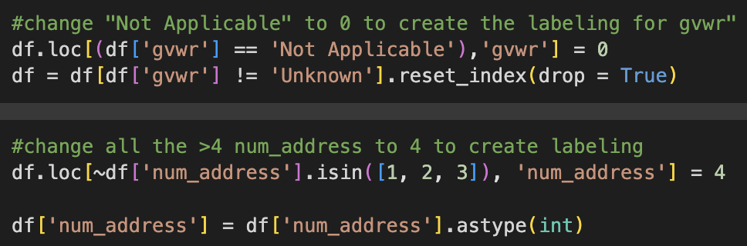
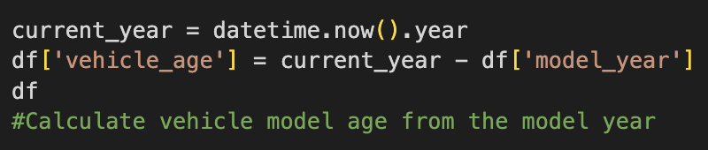
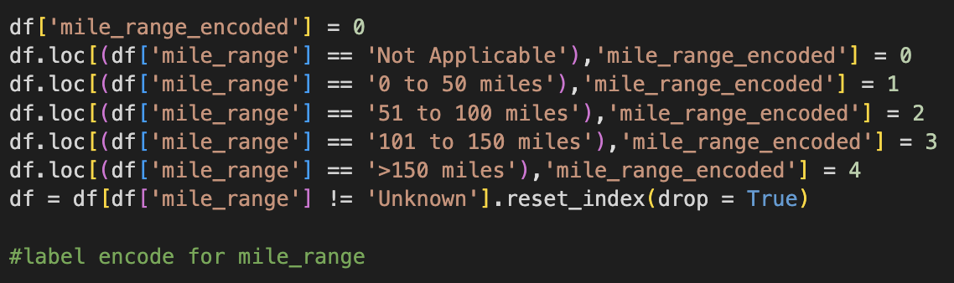
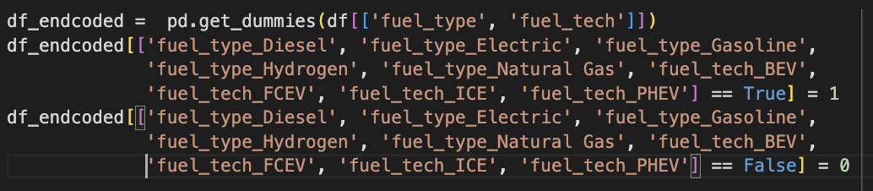
D A T A I M P U T A T I O N
Encode methods
Target Encoding: category
Label Encoding: gvwr_class, mile_range, num_address
One-hot Encoding: fuel_type, fuel_tech

Slide 7

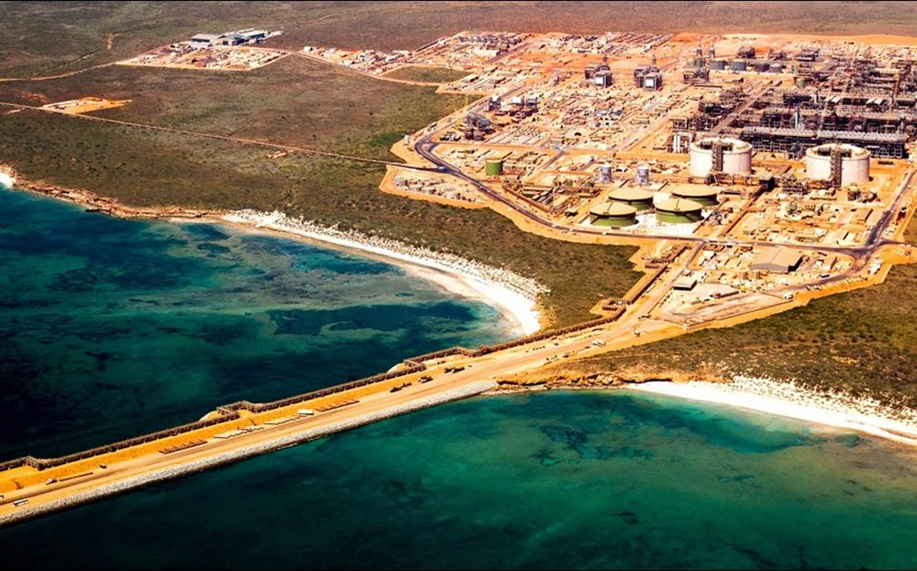
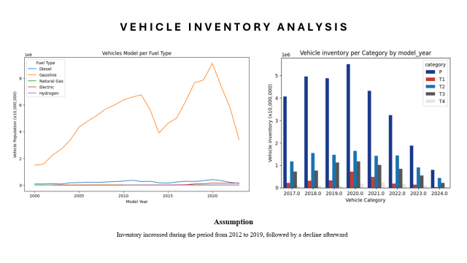
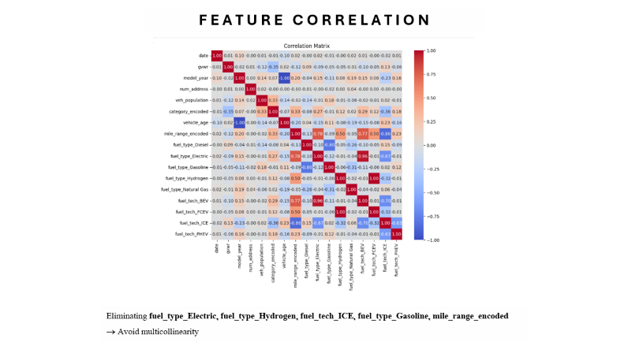
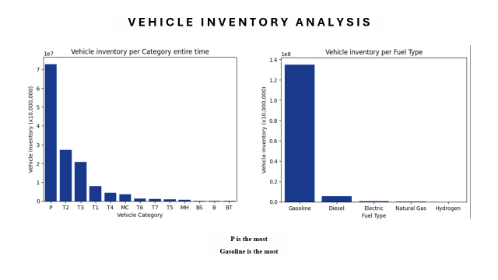
E X P L O R A T O R Y D A T A A N A L Y S I S ( E D A )
01
02
03
04
05

Slide 8
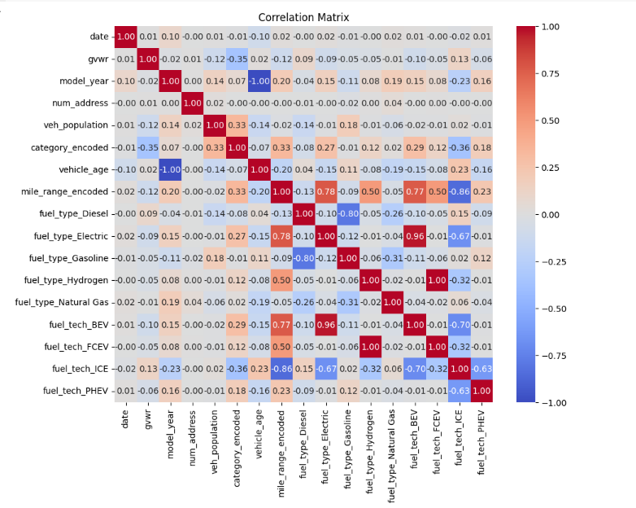
F E A T U R E C O R R E L A T I O N
Eliminating fuel_type_Electric, fuel_type_Hydrogen, fuel_tech_ICE, fuel_type_Gasoline, mile_range_encoded → Avoid multicollinearity

Slide 9
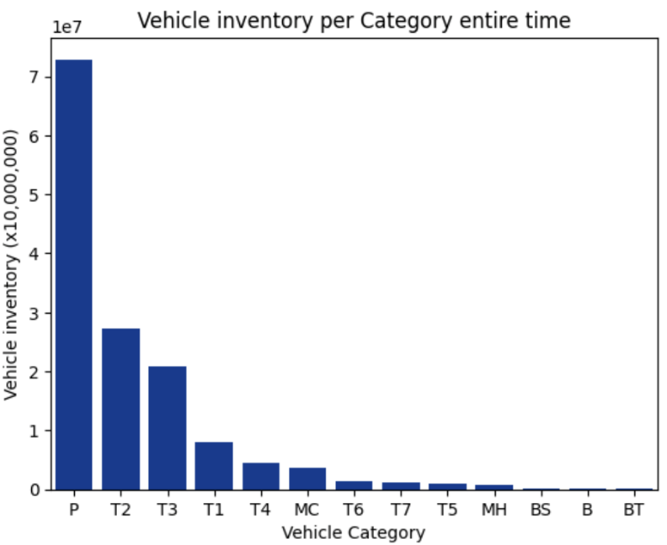
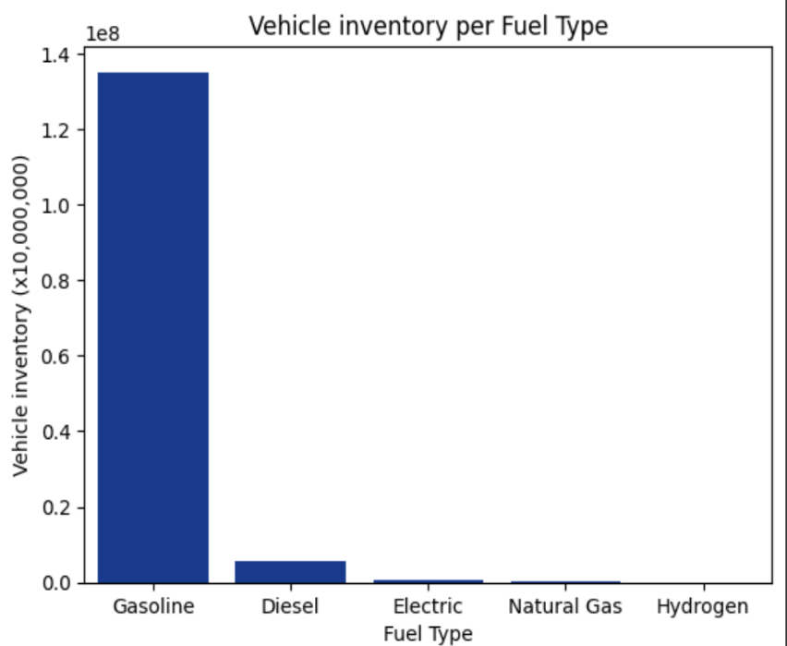
V E H I C L E I N V E N T O R Y A N A L Y S I S
P is the most
Gasoline is the most

Slide 10
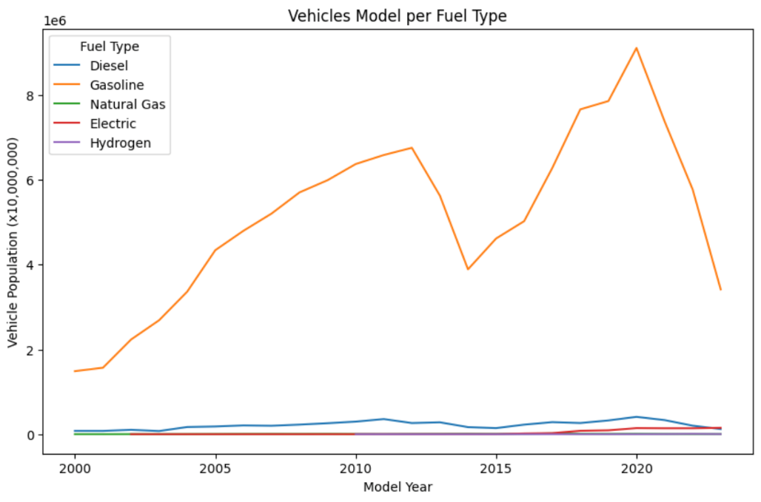
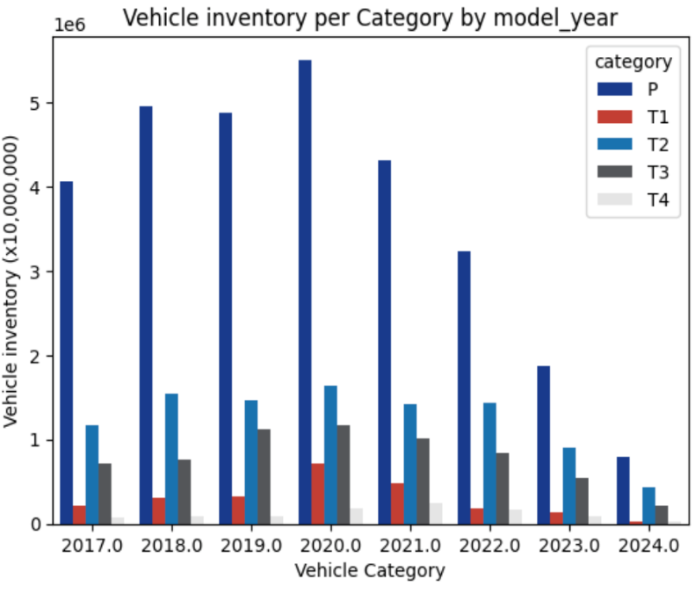
V E H I C L E I N V E N T O R Y A N A L Y S I S
Assumption
Inventory increased during the period from 2012 to 2019, followed by a decline afterward

Slide 11
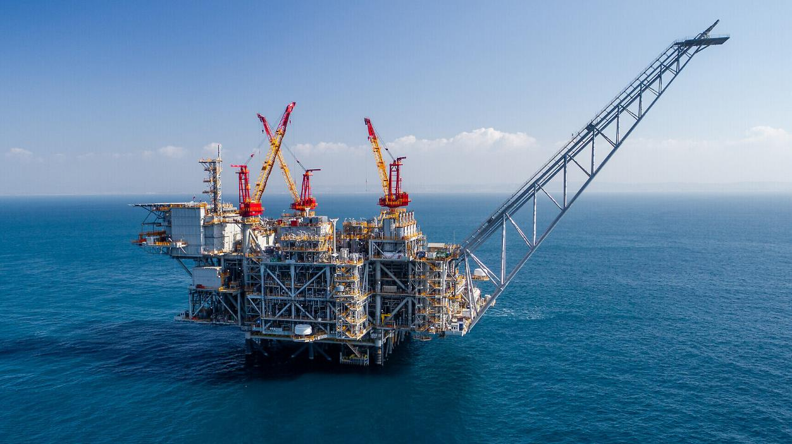
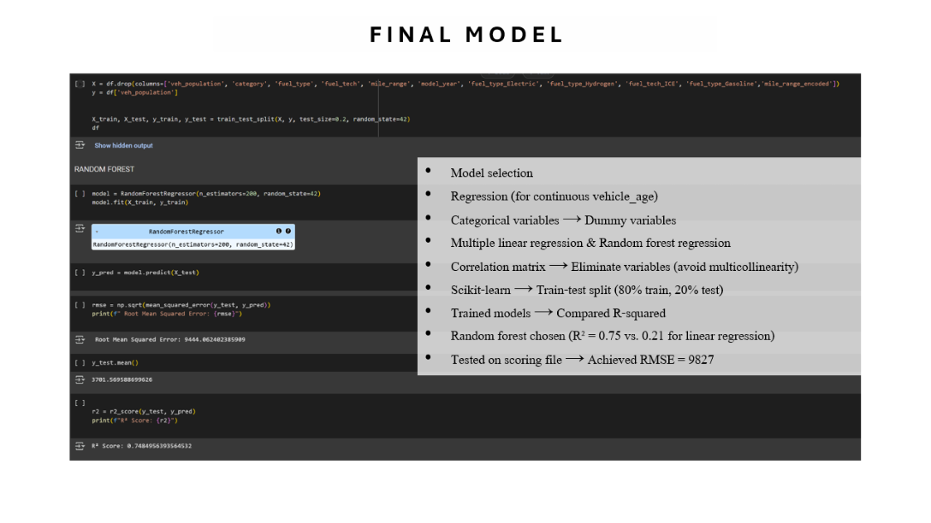
F I N A L M O D E L & A N A L Y S I S
01
02
03
04
05

Slide 12
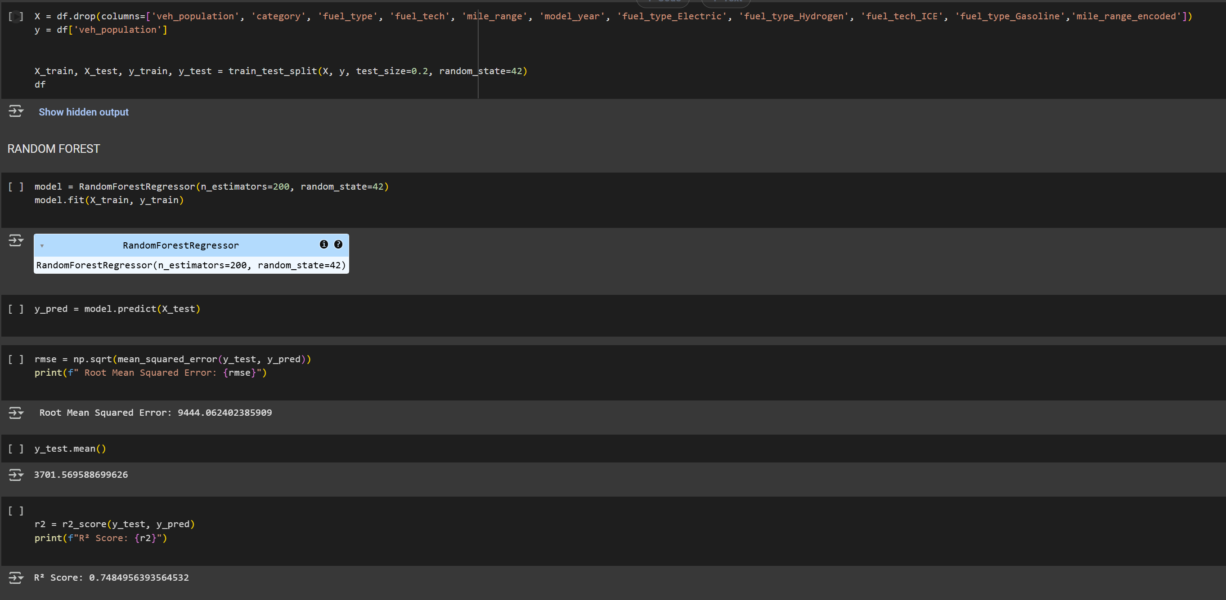
F I N A L M O D E L
Model selection
Regression (for continuous vehicle_age)
Categorical variables → Dummy variables
Multiple linear regression & Random forest regression
Correlation matrix → Eliminate variables (avoid multicollinearity)
Scikit-learn → Train-test split (80% train, 20% test)
Trained models → Compared R-squared
Random forest chosen (R² = 0.75 vs. 0.21 for linear regression)
Tested on scoring file → Achieved RMSE = 9827

Slide 13
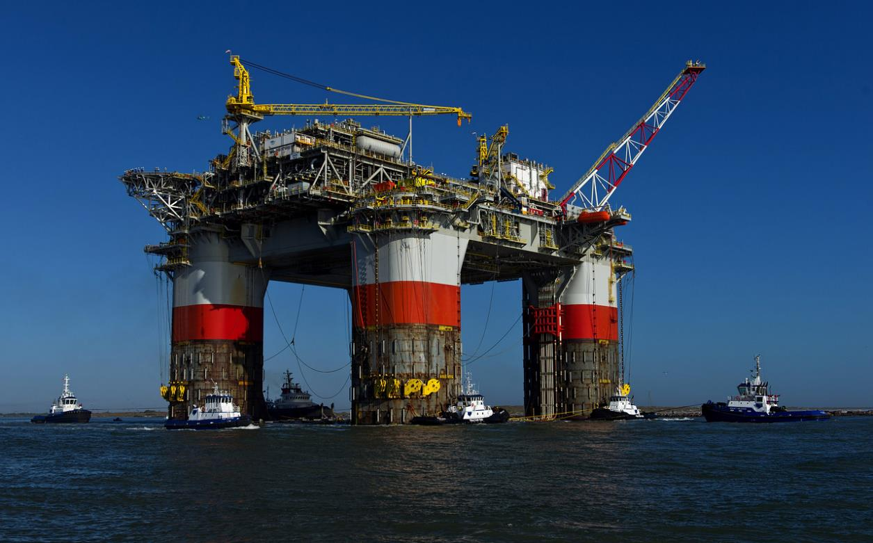
P O T E N T I A L I M P R O V E M E N T S
Further finetune machine learning model
More thoroughly analyze industry external data and news to provide better insights
01
02
03
04
05

Slide 14
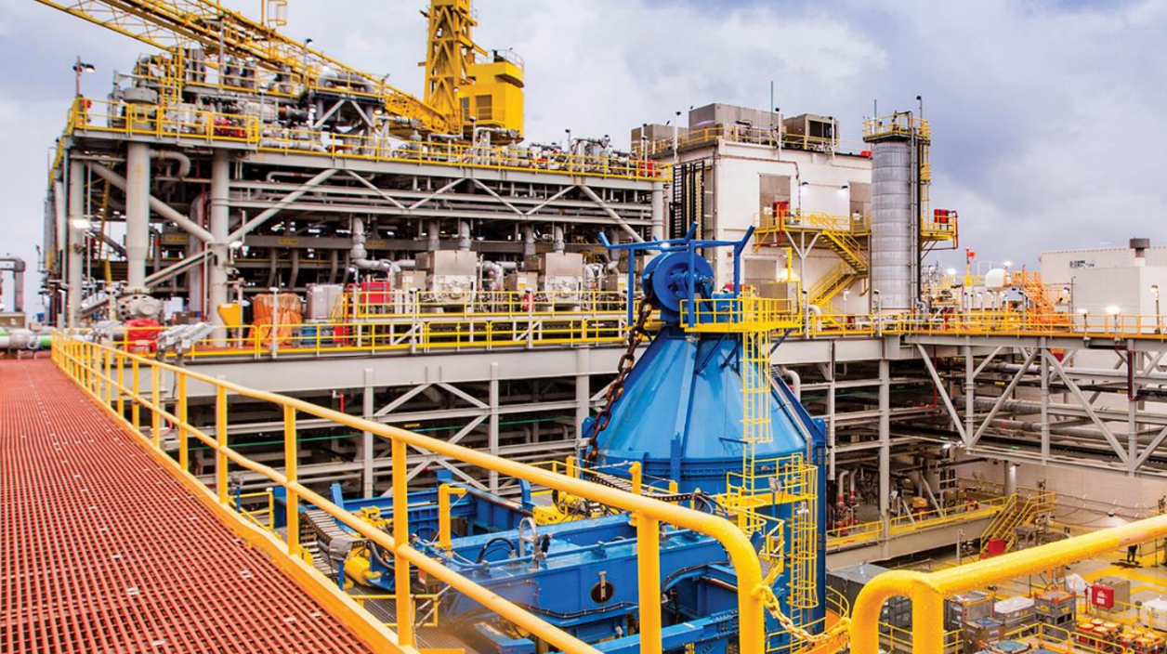
T E C H N O L O G I E S U S E D
Python (Pandas, NumPy, Matplotlib, Seaborn, Sci-kit-learn)
Google Collaborator
Machine Learning
Excel
PowerPoint
01
02
03
04
05

Slide 16
THANK YOU

Slide 17



TEAM MEMBERS
Giang Dao
Technical Project Manager
Nguyen Thai
Data Scientist
Tila Bui
Visualization Specialist

